Slide 1

IOT LEVEL 1 ARCHITECTURE
Done By:
Ukeshwar Sathiyamoorthy
Febin Pj
Deepak R
Dhanesh Seenivasan

Slide 2
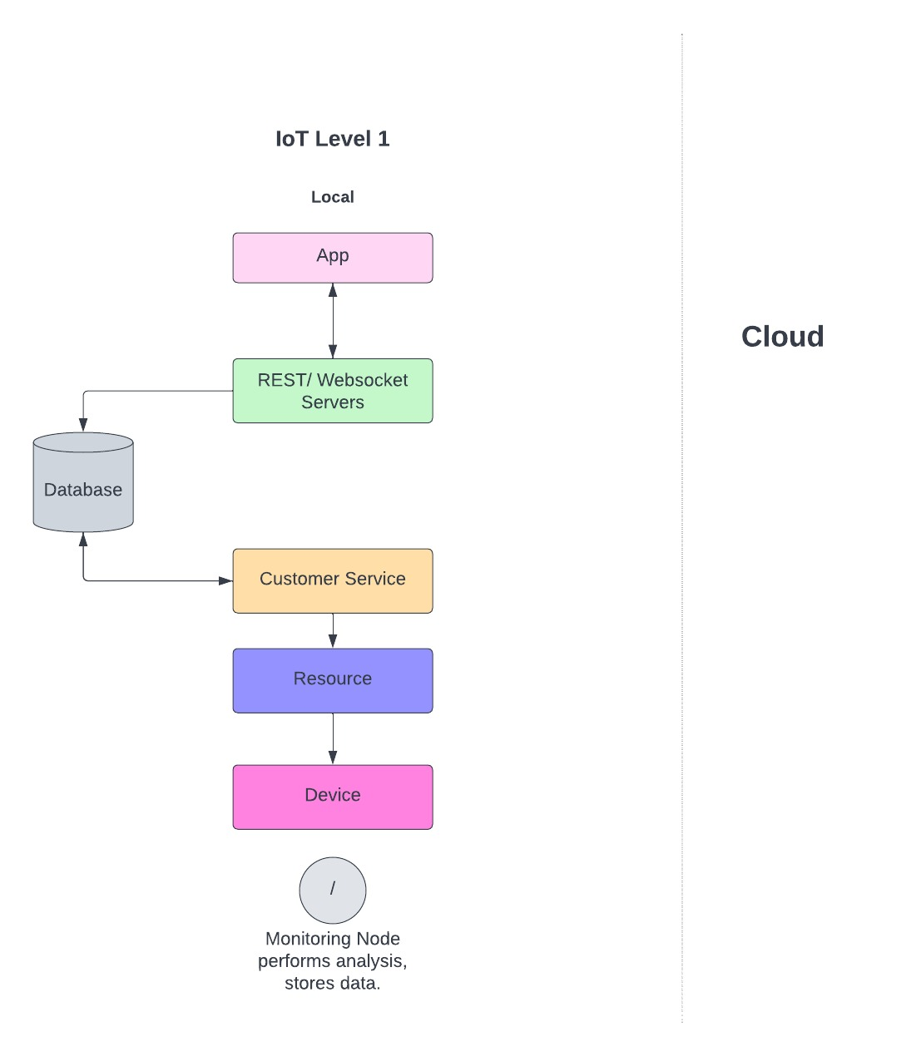
LEVEL 1 TEMPLATE

Slide 3
Components
Device: A device which sense, identifies and remote sensing capabilities.
Resource: These are software components on IoT devices for accessing and processing. storing software components or controlling actuators connected to the device.
Controller Service: It is a service that runs on the device and interacts with web services. The controller service sends data from the device to the web service and receives commands from the application via web services for controlling the device.

Slide 4
Components
Database: Stores data generated from the device
Web Service: It provides a link between IoT devices, applications, databases, and analysis components.
Analysis Component: It performs an analysis of the data generated by the lol device and generates results in a form which are easy for the user to understand.
Application: It provides a system for the user to view the system status and view product data. It also allows users to control and monitor various aspects of the IoT system.

Slide 5
Example
IoT device which that monitors the lights in a house.
The lights are controlled through switches.
The database has maintained the status of each light and also REST services deployed locally allow retrieving and updating the state of each light and trigger the switches accordingly.
For controlling the lights and applications, the application has an interface.
The device is connected to the internet and hence the application can be accessed remotely as well.

Slide 6
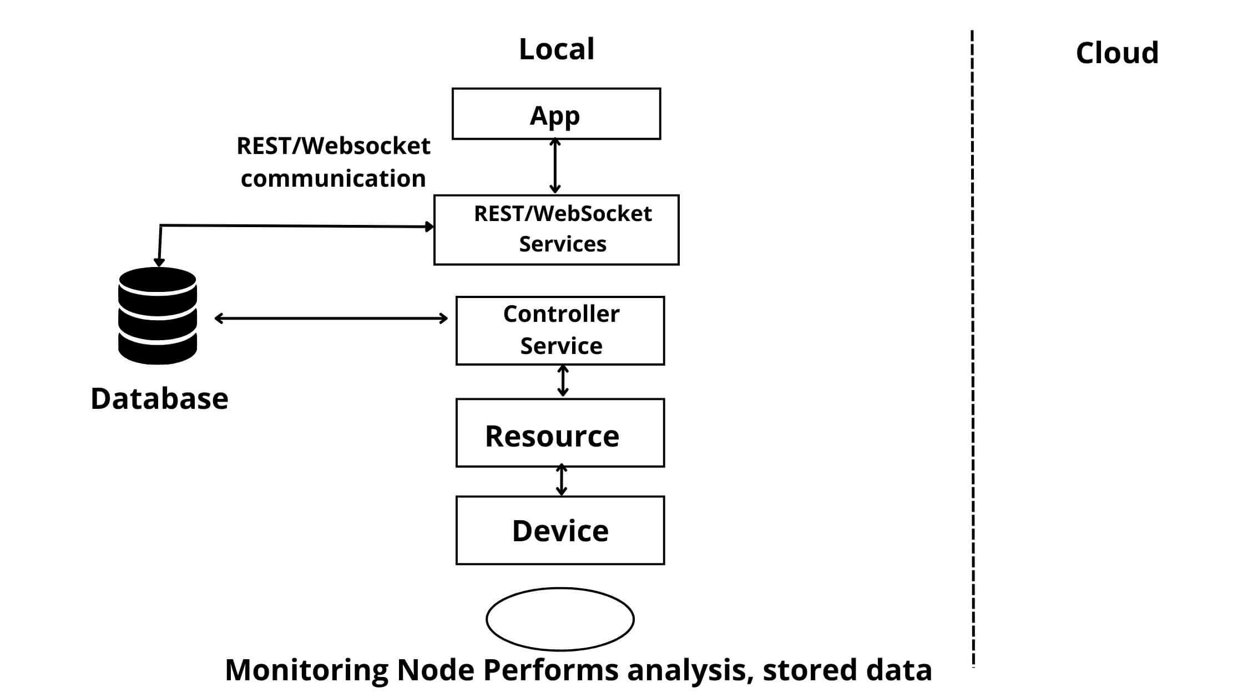

Slide 7

THANK YOU

